Slide 1



BanglaMusicMooD: A Music Mood Classifier
from Bangla Music Lyrics
Paper_Id - ICMCSI0125

Slide 2






Authors
Nazia Parvin Urmi
Nasir Uddin Ahmed
Md. Habibur Rahman Sifat
Salekul Islam
Abu Shafin Mohammad Mahdee Jameel

Slide 3






Index
INTRODUCTION
RELATED WORK
PROPOSED METHOD
OUR CONTRIBUTION
RESULTS
FUTURE WORK

Slide 4






Introduction
Music a form of recreation
Influencing mood
Bangla music mood classifier
Finding emotion
Ensemble learning

Slide 5



Related Work
Widowati, Fika Ulfa and Nugroho, Fitriyanto Santi and Shidik, Guruh Fajar: Classification of Music Moods Based on CNN. In: 2018 International Seminar on Application for Technology of Information and Communication.pp318–321.IEEE (2018).
Kashyap, Nirbhay and Choudhury, Tanupriya and Chaudhary, Dev Kumar and Lal, Roshan : Mood based classification of music by analyzing lyrical data using text mining.In: 2016 International Conference on Micro-Electronics and Telecommunication Engineering (ICMETE) pp.287–292.IEEE (2016).
Raschka, Sebastian : MusicMood: Predicting the mood of music from song lyrics using machine learning. In :arXiv preprint arXiv:1611.00138 (2016).

Slide 6

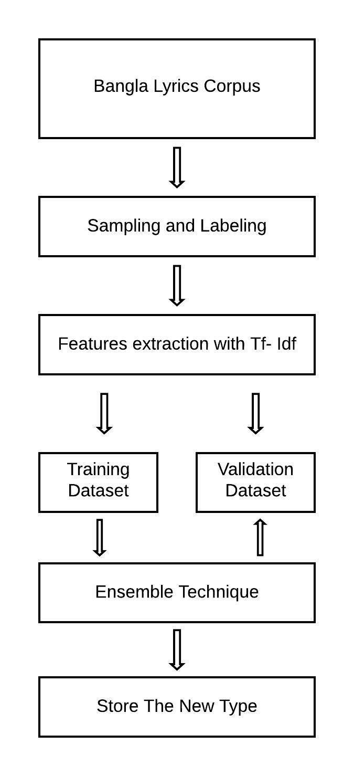
Proposed Method
Figure 1: Flowchart of the Proposed Method

Slide 7
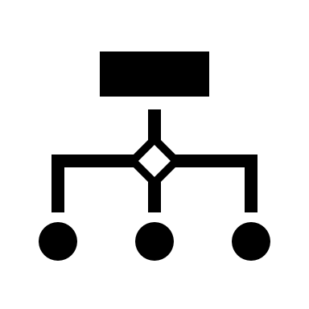

Sampling and Labeling
CREATING THE DATASET
LABELING THE SONGS BASED ON LYRICS

Slide 8
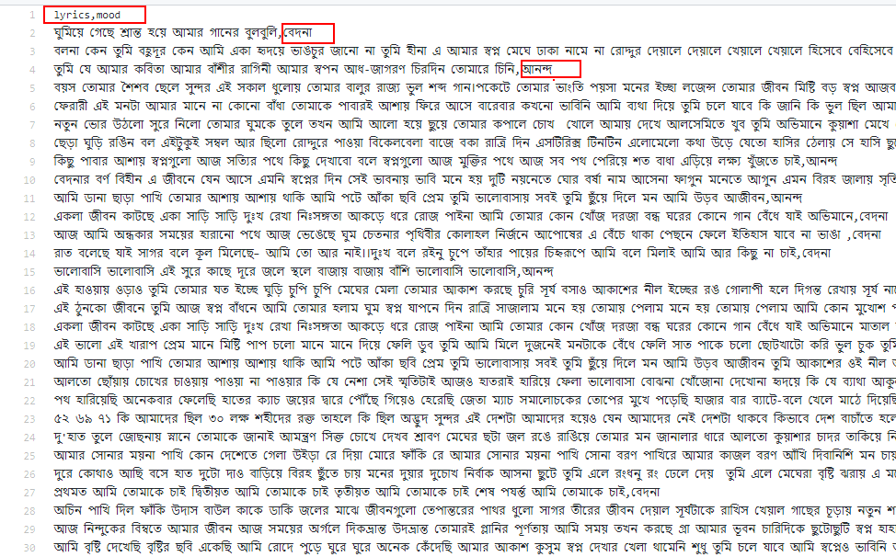
Our Dataset
Figure 2: Dataset

Slide 9


Build Token
Using porter tokenizer
Removing Bengali stop words

Slide 10


Features Extraction
Using Tf-Idf
Term Frequency
Inverse Document Frequency

Slide 11
Formulas
tf-idf (t, d) = tf (t, d) * idf (t)
id f (t) = log ((1+nd)/ (1+df (t,d))) + 1

Slide 12
Ensemble Technique
Bagging
2. Boosting

Slide 13
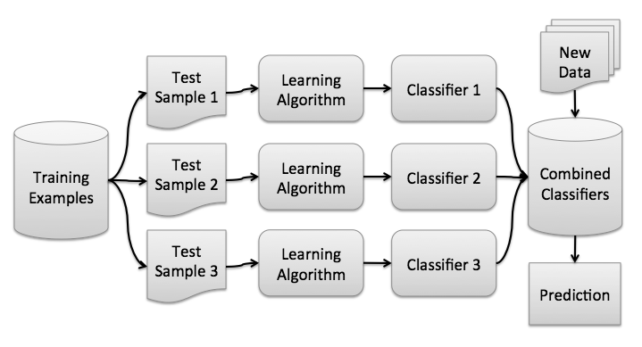
Bagging
Figure 3: Workflow of the Bagging technique

Slide 14
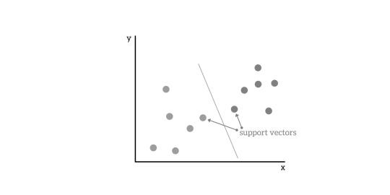
Bagging with SVM
Figure 4: SVM diagram

Slide 15


Our Contribution
Creating Bangla song lyrics dataset
Predicting the mood of the song

Slide 16

Results

Slide 17

Formulas
precision = TP/(TP + FP)
recall = TP/(TP + FN)
F1 = 2*(precision*recall)/(precision + recall)

Slide 18
Accuracy
Accuracy | Values
Training Accuracy | 0.9375
Test Accuracy | 0.875
Table 1: Accuracy results

Slide 19
Model Evaluation
 | precision | recall | F1-score | support
Happy | .50 | .33 | .40 | 3
Sad | .67 | .80 | .73 | 5
Accuracy | - | - | .62 | 8
Macro avg | .58 | .57 | .56 | 8
Weighted avg | .60 | .62 | .60 | 8
Table 2: Model Evaluation results

Slide 20
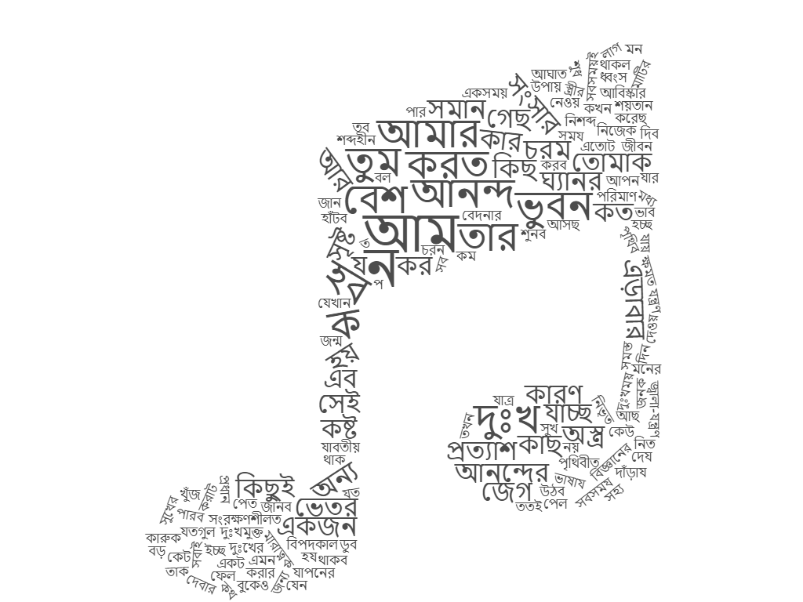

Word Cloud
Figure 5: Happy words
Figure 6: Sad words

Slide 21


Future Work
ENLARGE THE DATASET
APPLYING NEURAL NETWORKS

Slide 22

Any questions

Slide 23
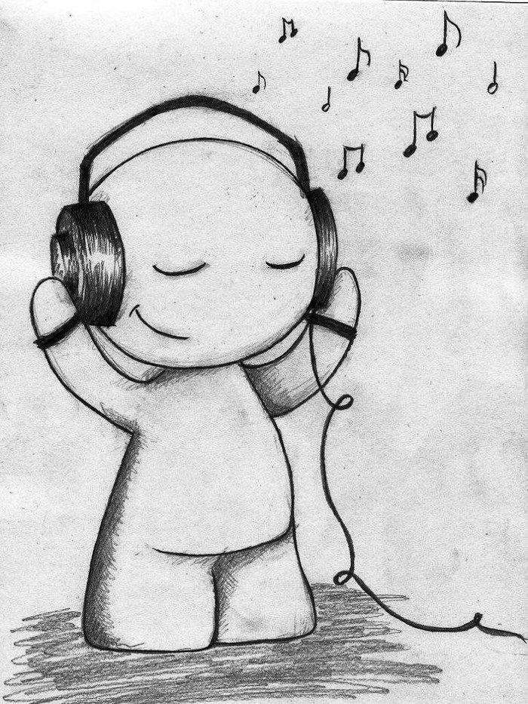
Thank You

